Slide 1
Impact of Learning Rate in Q-Learning
CS 352 - Introduction to Reinforcement Learning
Course Project Presentation
Mohammed Haider Abbas Muhammad Ahsan

Slide 2
Overview
Q-Learning
Taxi Problem
Our Objective
Results
Conclusion
GitHub

Slide 3
Q-Learning Algorithm

Slide 5
Taxi Problem

Slide 6
Our Objective

Slide 7
Results

Slide 8
Conclusion

Slide 9
GitHub Repository:
https://github.com/haider-06418/RL-Project

Slide 10
Thank you!

Slide 11
Implementing Q-Learning algorithm on the Taxi learning problem and analyzing it for various values of α (Learning rate)

Slide 12
Introduction to Reinforcement Learning and Q-Learning Algorithm
Reinforcement Learning involves learning through interaction with an environment
Q-learning is a popular, model-free, off-policy algorithm that seeks to learn the optimal action-value function for a given task
Q-learning iteratively updates the Q-values of each state-action pair based on rewards received by the agent and predicted future rewards
The Taxi Problem is a classical problem in Reinforcement Learning where the agent (taxi) needs to pick up and deliver a passenger in a 5x5 grid world
There are six available actions in the game: LEFT, RIGHT, UP, DOWN, PICKUP, and PUTDOWN
The agent receives a reward of -1 at each step, but a reward of 20 upon successful delivery and -10 for illegal actions
There are 500 states in the problem without any state abstraction.

Slide 13
Implementation and Hyperparameters of Q-Learning
Tabular Q-learning approach used to learn optimal policy by maintaining a table of state-action values
Q-values initialized to 0 for all state-action pairs, and a decayed epsilon-greedy policy used to explore state space
Learning rate alpha (α) varied from 0.1 to 0.9 in increments of 0.1, and also tested for very small and very large α values
Hyperparameters set throughout: discount rate (γ) = 1.0, exploration rate (ε) = 0.1, number of episodes = 10,000
Performance evaluated in terms of computational efficiency (time taken to converge) and maximizing reward (average reward obtained)
Total of 5 independent runs conducted for each α value and the mean of performance metrics recorded
Randomized starting states and passenger/destination locations used to ensure generalization to different scenarios.

Slide 14
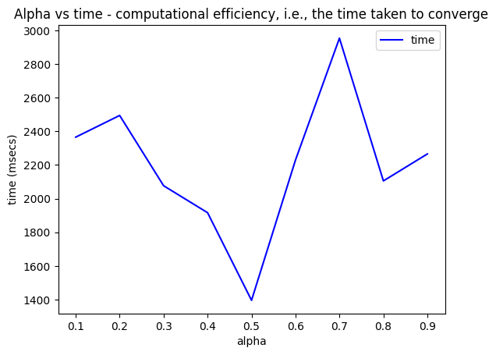
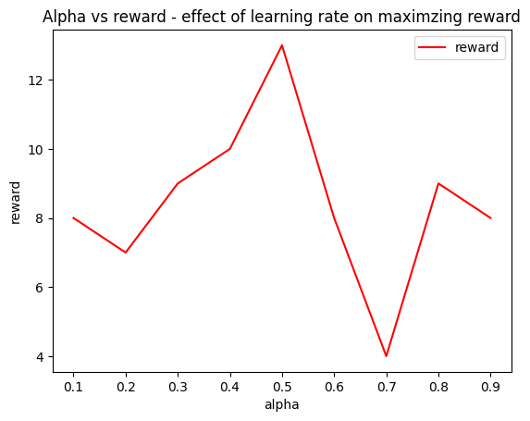
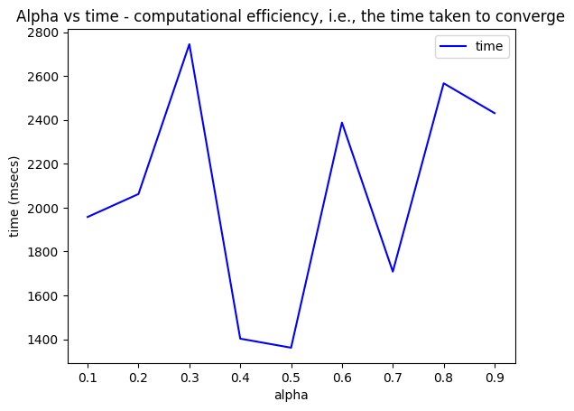
Impact of Alpha on Agent's Performance
α has a significant impact on the agent's performance
Choosing an appropriate value for α is important for the Q-learning algorithm to converge to the optimal policy
The agent's convergence time varies with different α values
Very low or very high α values result in longer convergence times
The agent's convergence time varies with very small α values
The agent will not maximize reward and will take longer to converge for very small α values
α = 0 results in the agent failing to converge
The agent's reward varies with different α values
The learning rate at which we get the maximum reward is in the range of 0.4 to 0.6, mostly at 0.5

Slide 15
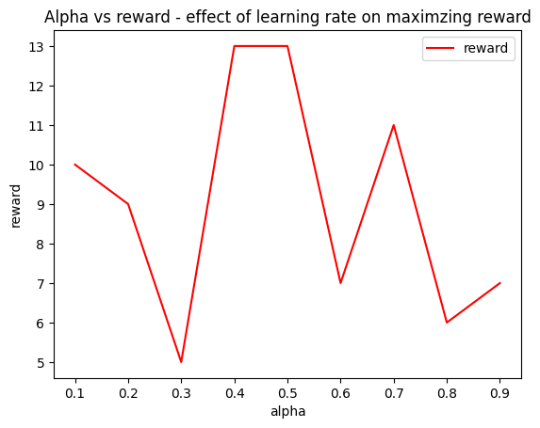
Relation between time taken to converge and reward
Time taken to converge and reward have an inverse relation
Maximizing reward is inversely proportional to computational efficiency, i.e. time taken to converge
Agent takes less time to obtain maximum reward and vice versa
For rest of the plots
The agent's reward varies with different convergence times
For more time, the reward is less and for less time, the reward is more
There is an inverse relationship between time taken to converge and reward
The agent's reward varies with α = 0 and α = 1
α = 0 results in the agent failing to converge and α = 1 results in longer convergence time and lower reward
At 0.4 ≤ α ≤ 0.6, we get maximum reward and least time to converge

Slide 16
CONCLUSION
Choice of α significantly impacts agent's performance in Q-learning algorithm.
An appropriate value of α is crucial for the algorithm to converge to optimal policy.
Plots 1 and 2 show that if α is too high or too low, the agent may require more time to converge, lowering reward.
Optimal range for α is 0.4 to 0.6, with α = 0.5 showing the least time to converge and maximum reward.
Very low or very high α values result in higher time taken to converge than normal range of α values.
Time taken to converge is inversely proportional to the reward obtained, emphasizing the importance of maximizing reward and computational efficiency.
It is recommended to choose an appropriate value of α to maximize reward and computational efficiency in Q-learning algorithm.

Slide 17
THANKYOU!

